Slide 1
Linked Stars
FINDING RELATIONSHIPS BETWEEN CELEBRITIES…
Tarneet Singh Sidana
Vineet Gadodia

Slide 2
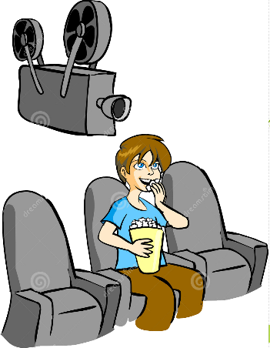

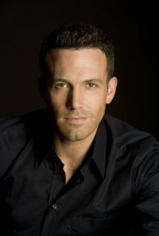
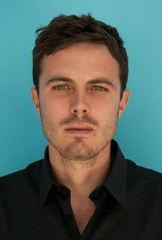
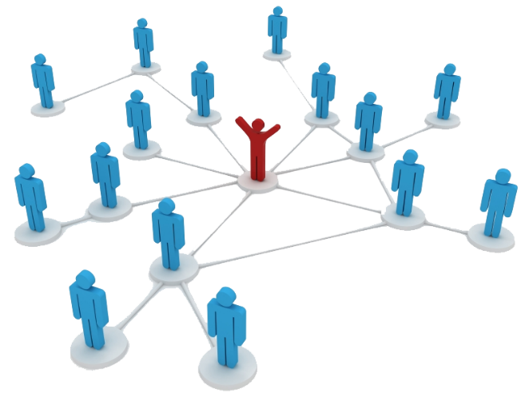
IDEA…
Ben Affleck
Casey Affleck
You liked the actors in the movie and want to know
more about them, find how else are they linked ?
Suppose you’re watching a movie….
Relations -
Family, Friends, Romantic
Current Affairs/News
Graphical Comparison by gross income
Movies, TV Shows, Music worked together!
Linked Stars
Celebrity Habits
Link-O-Meter
& much more…

Slide 3







data sources

Slide 4



data EXTRACTION
Celebrities & Movies
= 696 Celebrities
= 50,000+ Movies
Celebrity Records
Movie Records
Found the movies in which celebrities have worked.
= 24,653 Movies
Box Office Mojo
= 50,000+ Movies
IMDB/Freebase
= 12,317 Movies (after removing duplicates)
Record Linkage

Slide 5
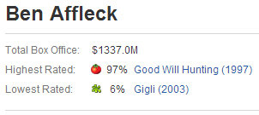
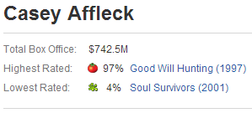
data EXTRACTION
Attributes
Reconciled following classes of attributes for celebrities :
People Attributes
Film Worked Attributes
Daily Life Attributes
Awards Attributes
TV Attributes
Music Attributes
= 175+ Attributes
Extracted the critic’s ratings for celebrities

Slide 6

data EXTRACTION
News
News
Match
Person Entities
Yes
No
Accept
Discard

Slide 7

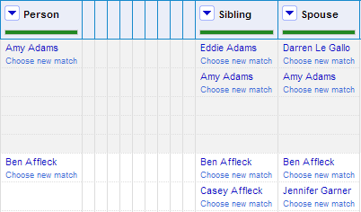
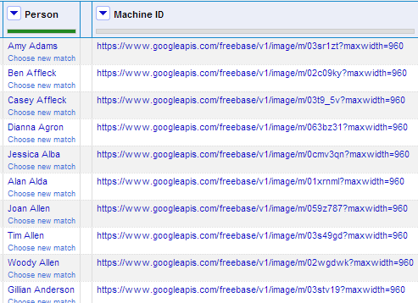

data CLEANING & TRANSFORMATION
Google Refine Expression Language (GREL)
https://www.googleapis.com/freebase/v1/image/ ?maxwidth=960

Slide 8
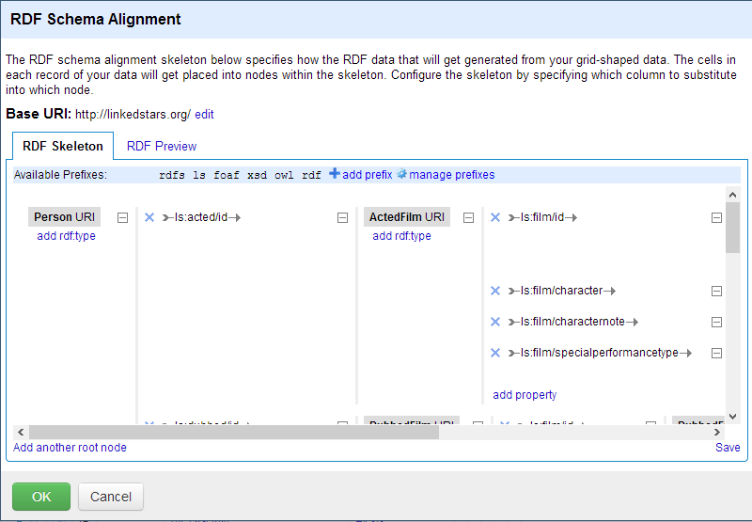
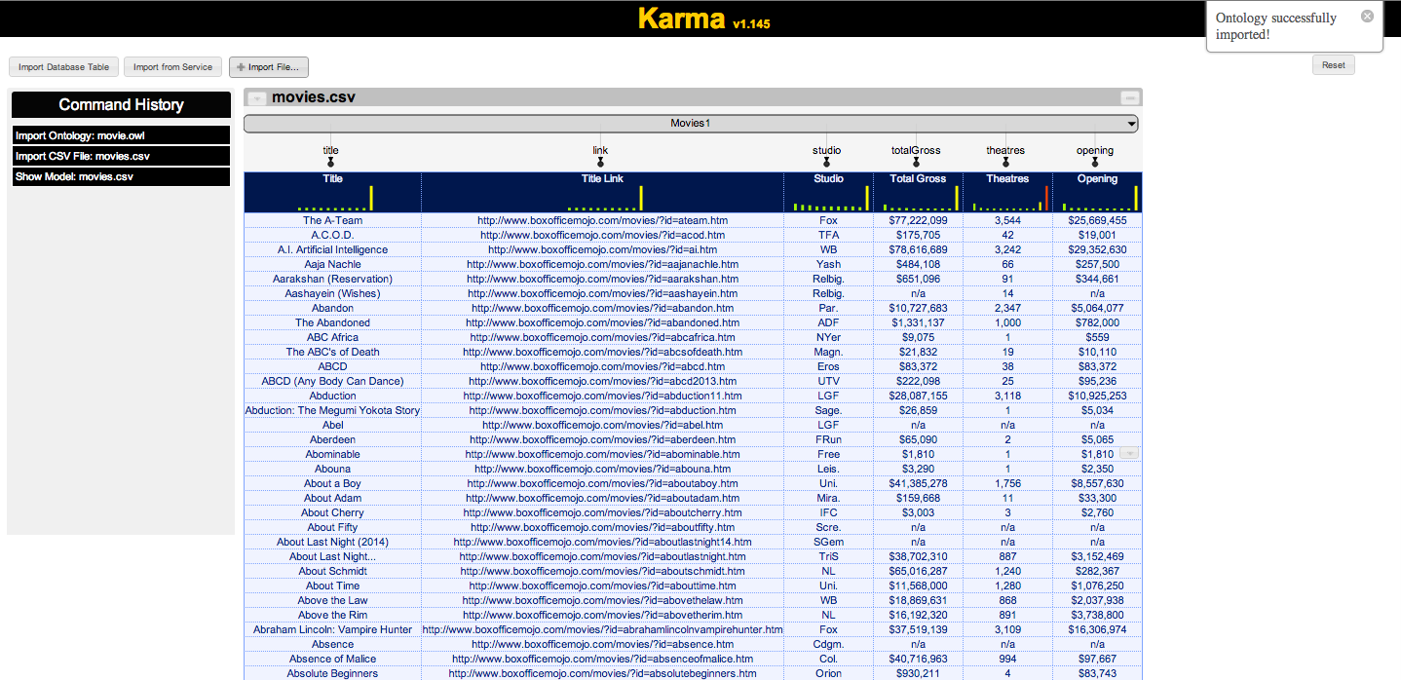
data LOADING
Making Hierarchical Ontology for 175+ Attributes, Celebrities & Movies.

Slide 9
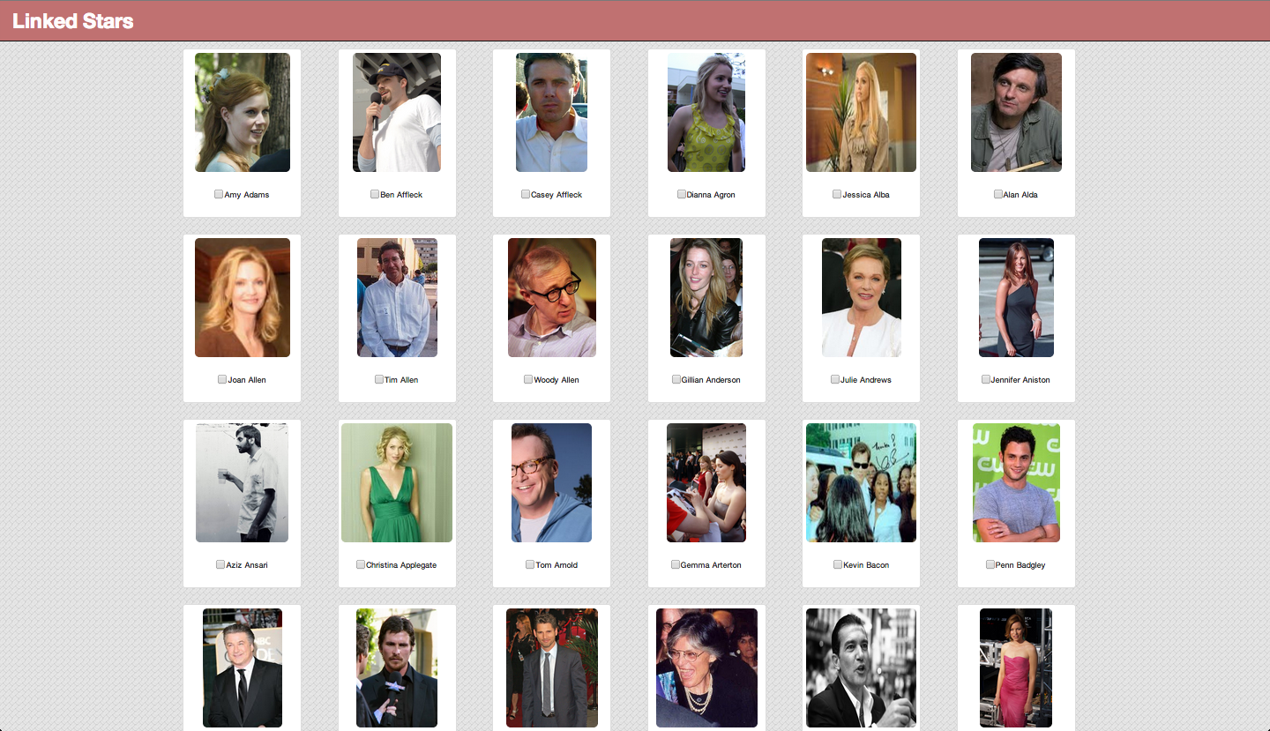
USER INTERFACE

Slide 10
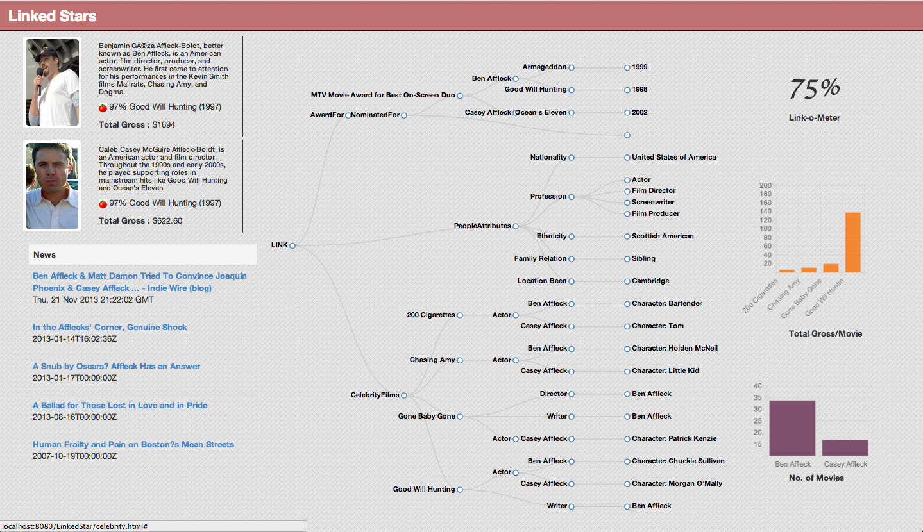
USER INTERFACE

Slide 11
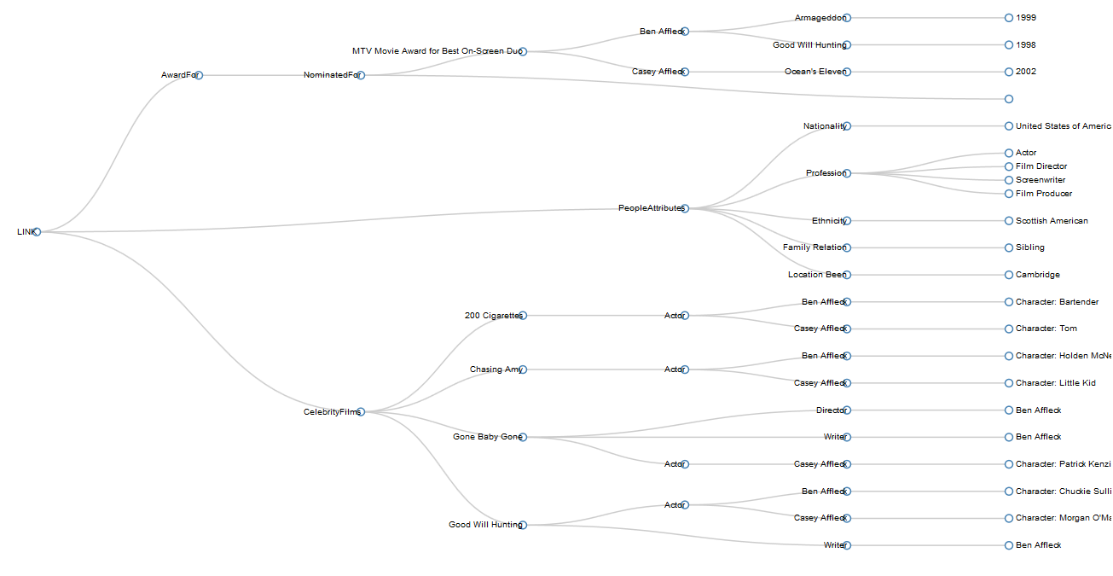
Linkage network

Slide 12

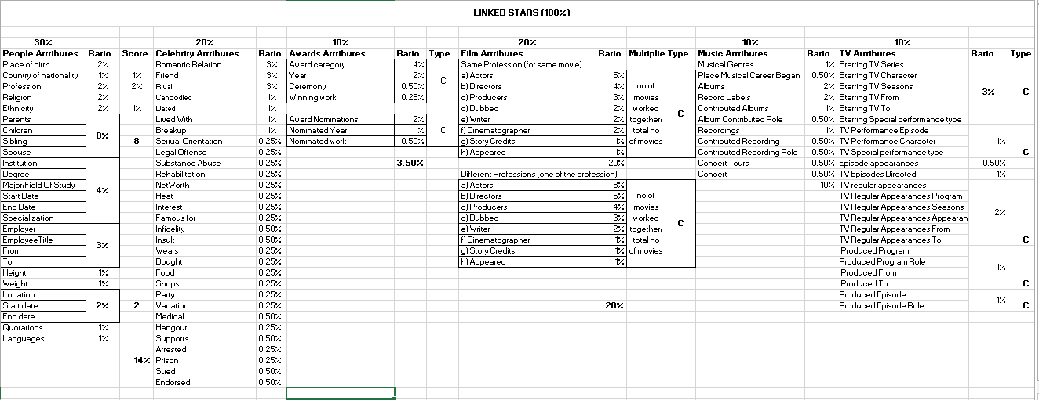
LINK-O-METER
Every attribute is given a rating, presence of which increases the link-o-meter.

Slide 13
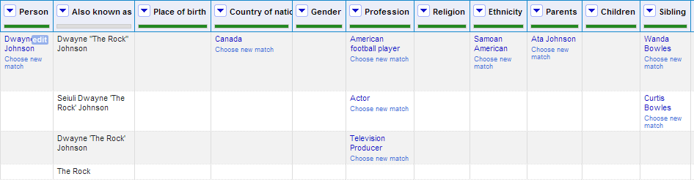
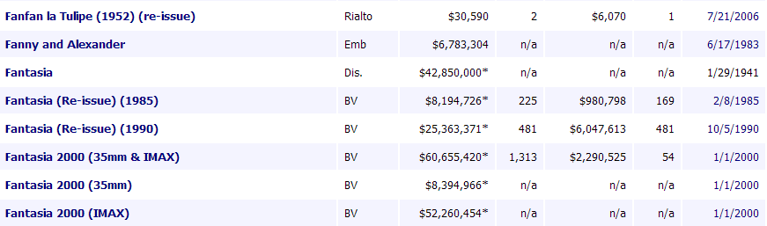
CHALLENGES
Data Integration:
Many celebrity were listed by their popular names instead of actual names.
Linkage challenges for celebrities with their middle names, unicode characters.
Linkage challenges for movies
with year, theatre etc. appended
in their name.

Slide 14
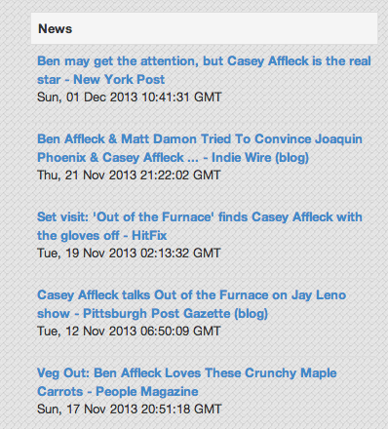
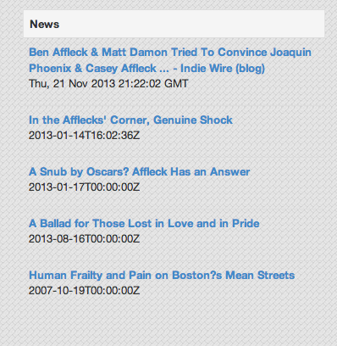
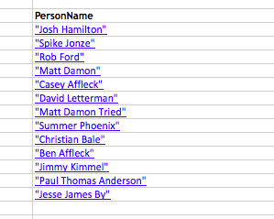

CHALLENGES
Wrong Scenario
Right Scenario

Slide 15
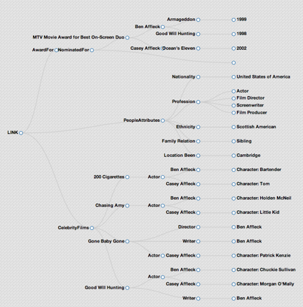
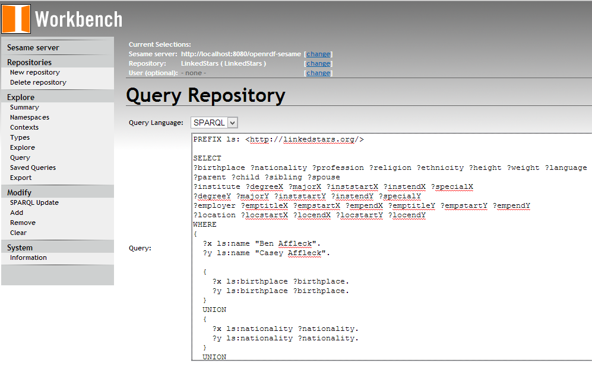
CHALLENGES
Writing complex SPARQL queries for various combinations of 175+ attributes to find linkages.
Converting them to the graph format using JSON.

Slide 16
evaluation
175+ Attributes
696 Celebrities
12,317 Movies

Slide 17

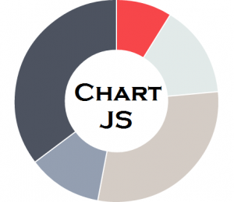


Technology used
Front-End Design Tools:
Twitter BootStrap
D3JS
ChartJS
jQuery, AJAX
Back-End Technology:
Java, Servlets, JSP
Open Sesame Workbench

Slide 18
LIMITATION
System doesn’t give information only for 1 star or more than 2 stars.

Slide 19
FUTURE WORK
Inclusion of Social Media Feeds
Integrating Directors, Writers & Other Celebrities…
Multiple Celebrity Linkage

Slide 20
THANK YOU!
HOPE IT WOULD HELP IN FINDING NEW RELATIONS FOR YOU!
Any Questions ?

